Slide 1

Development of School Admission Management System

Slide 2
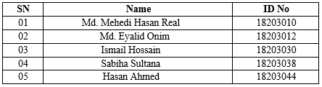
Prepared For
M.M. Rakibul Hasan
Senior Lecturer
Department of Computer Science and Engineering
Prepared by
Group: SEVEN

Slide 3
Table of Contents
Organizational Overview
Structure of Organization
Project Objectives
Project Objectives
Iterative Process Model
Feasibility Study
Requirements - Hardware
& Software
System Analysis & Design
System Planning & Project Scheduling
Analysis Modeling
Risk Management
Quality Assurance & Testing
Testing Design
Limitation of Project
Future Work
Project Demonstration
Conclusion

Slide 4
Organizational Overview
Enosis Solutions
Offshore software engineering and consultancy company.
Developed a unique collaborative model of partnering with clients to deliver great software products to market rapidly and economically.
Ongoing success as offshore partner for some of the world's leading software companies in the large scale Enterprise Computing and Numerical Mechanics space.

Slide 5



Structure of the Organization
Structure:
CEO
CEO
Assistant
Project
Manager
Business Analysis
Software
Development
Quality
Analysis
Analyst
Designer/ Programmer
Tester
Figure- 1: Organizational Structure

Slide 6
Project Objective
Broad Objectives
The broad objective is to develop a software that maintains all the process of admission procedure of a school
Specific Objectives
Distribute admission form online
Apply online
Approve or reject students online
Store students detail online
View the result online

Slide 7
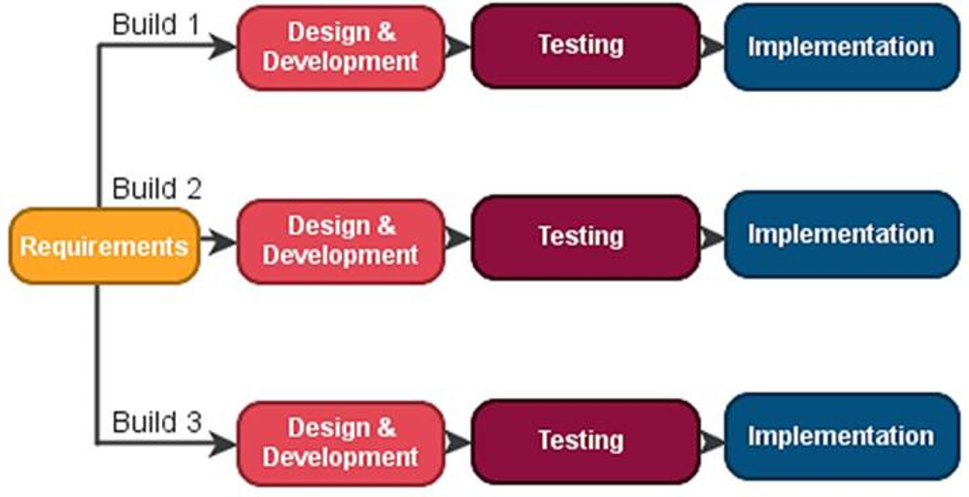
Iterative Process Model Feature of Iterative Process Model:
Clear Requirement and understand properly.
High Risk Features and Changeable goals.
Better for large and mission critical project.

Slide 8
Feasibility Study
Technical Feasibility
This project is technically feasible because for making this
project the require technology is available.
Economic Feasibility
This project is economically feasible because the total personnel cost, time, software and hardware cost for making this project is less than the client budget. Operational Feasibility
This project is operationally feasible because the actual or
target user are able to use the project nicely.

Slide 9
Requirements Engineering
Hardware Requirements
A minimum of Pentium 4 with a speed of 1.3 GHz.
A minimum RAM capacity of at least 512MB.
Hard disk capacity of at least 100mb free space
Software Requirements
Windows 7 and above.
Xampp Server.
Web Browser (Firefox or Chrome)

Slide 10
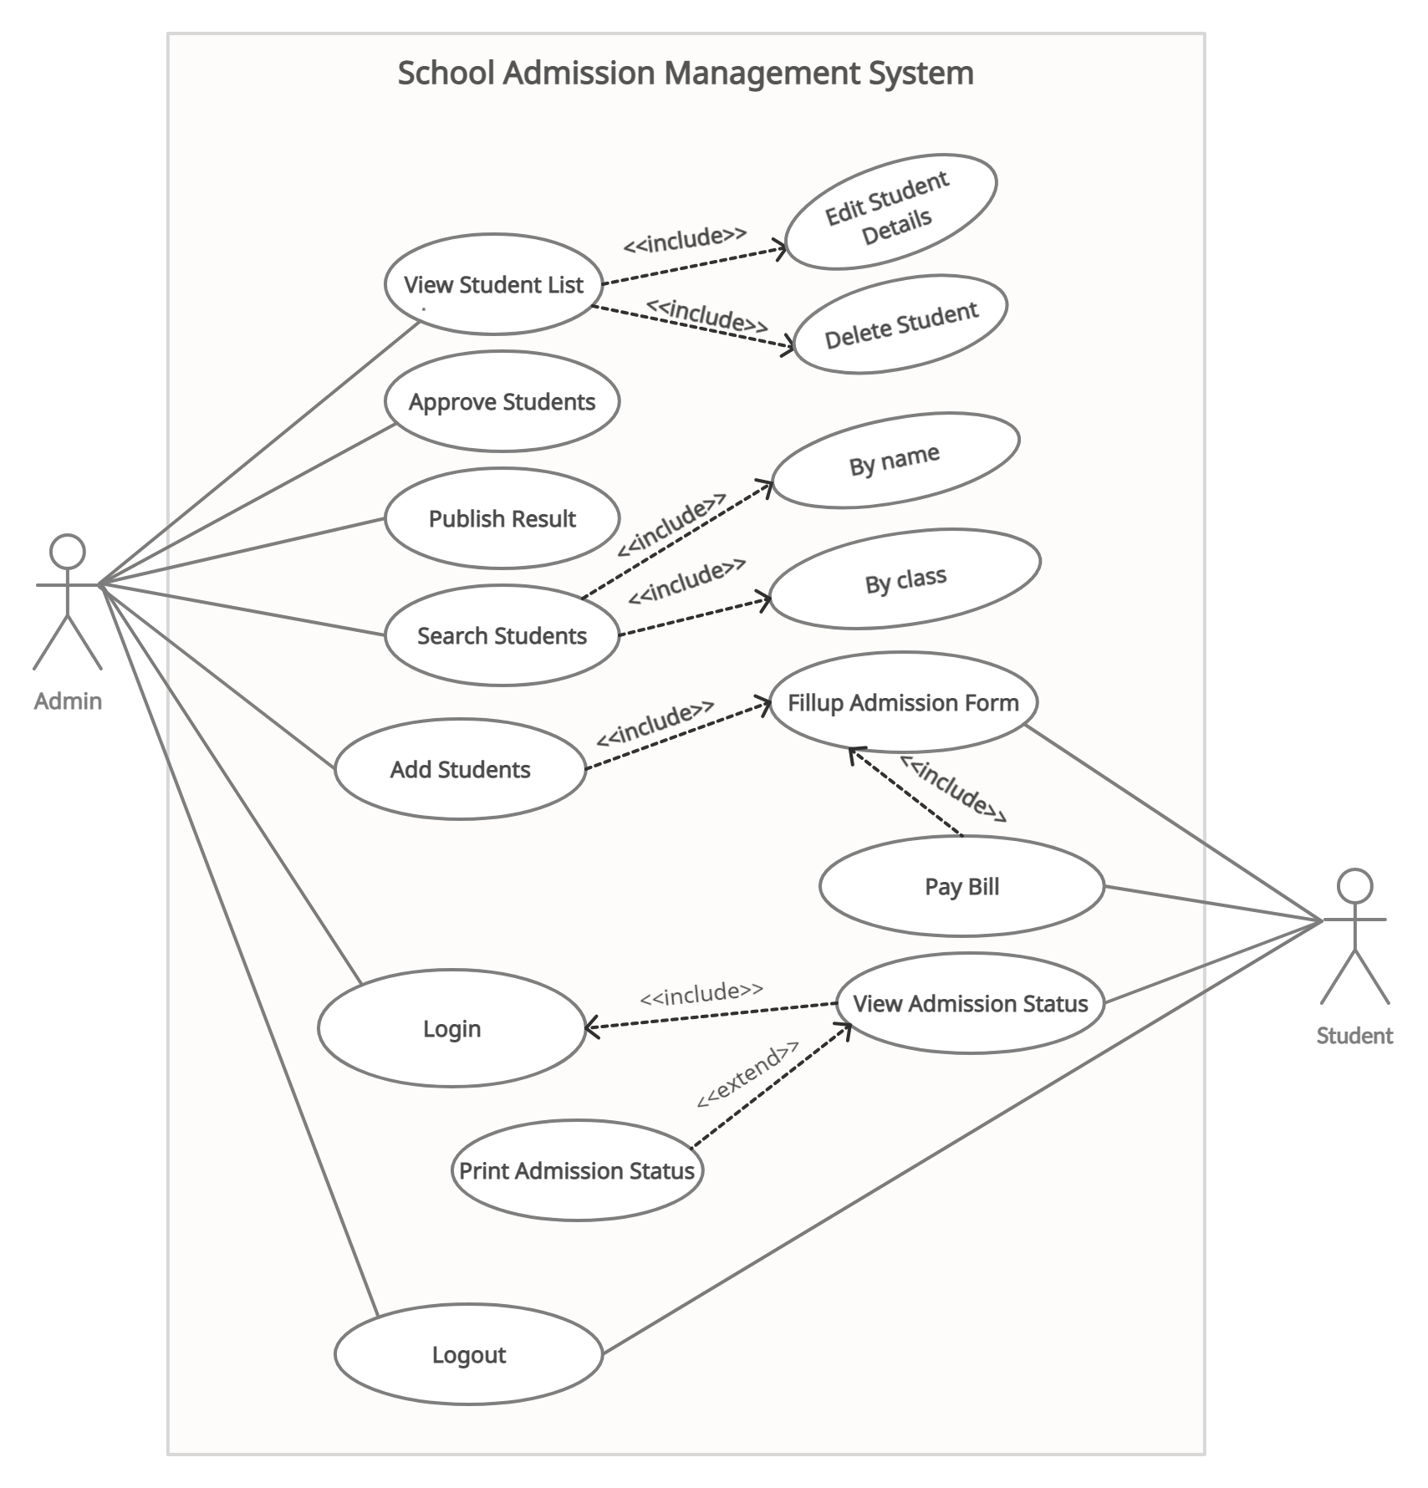
System Analysis and Design
USE CASE DIAGRAM:

Slide 11
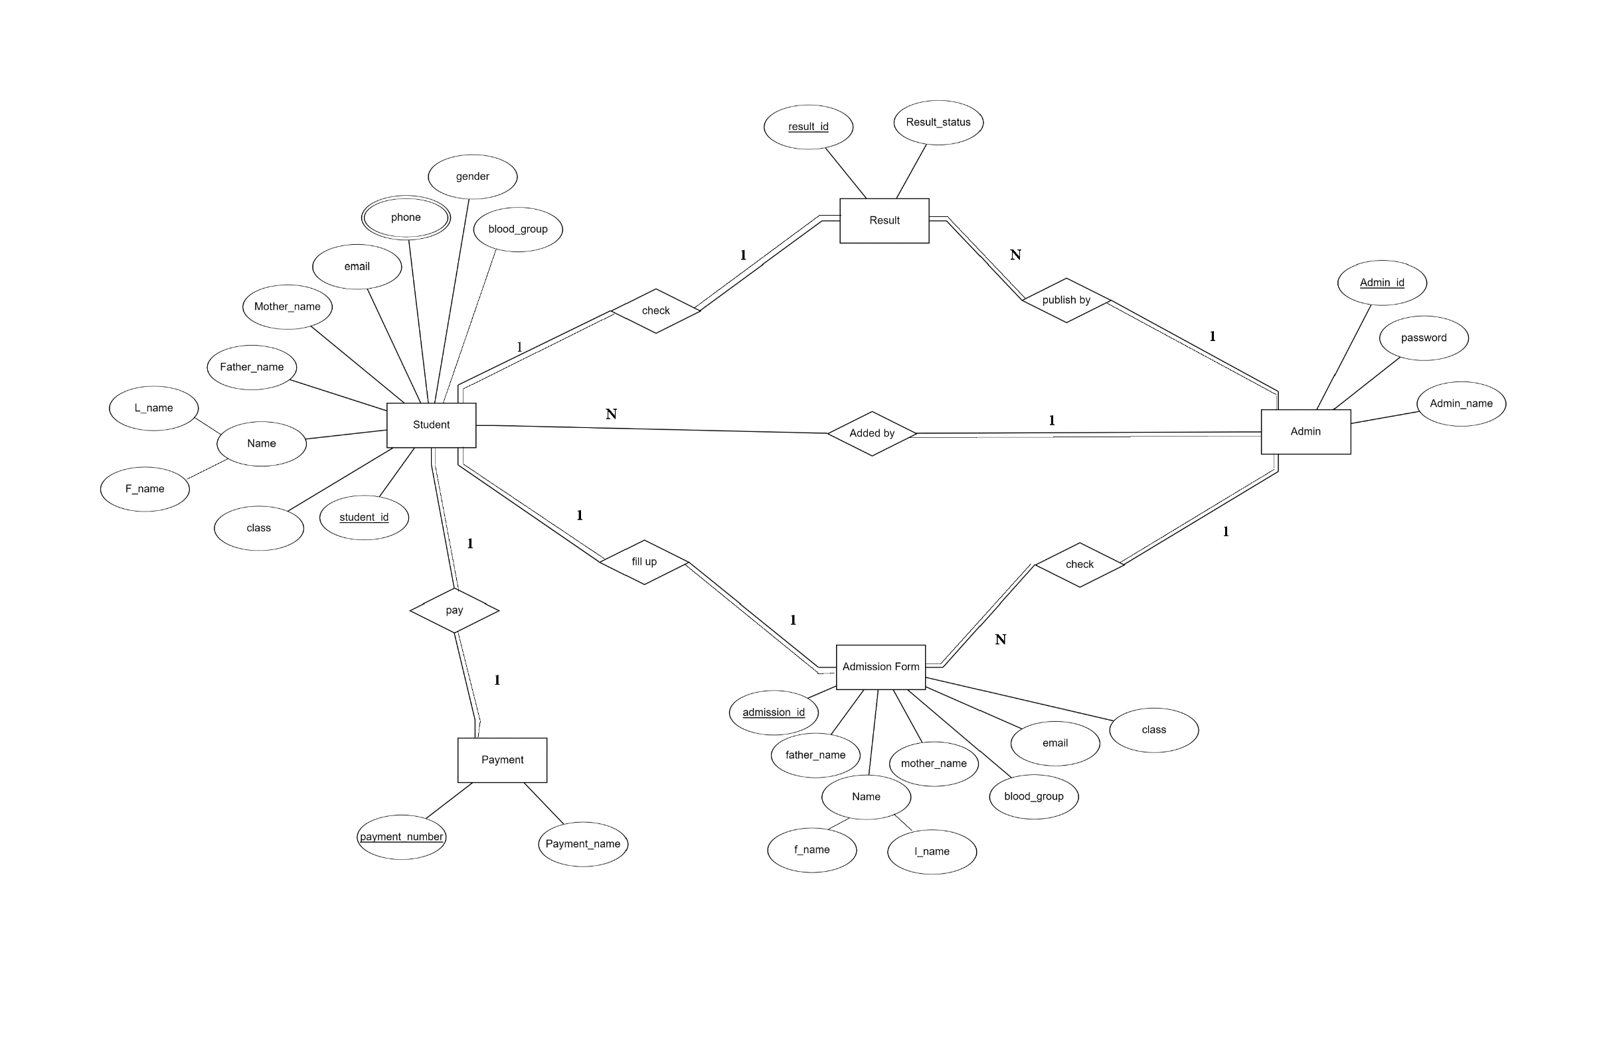
System Analysis and Design: ERD

Slide 12
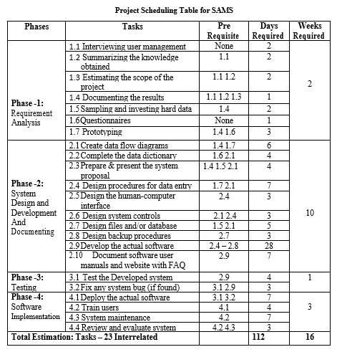
System Planning & Project Scheduling

Slide 13
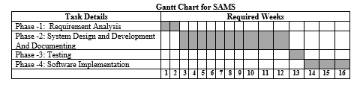
System Planning & Project Scheduling(Gannt Chart)

Slide 14
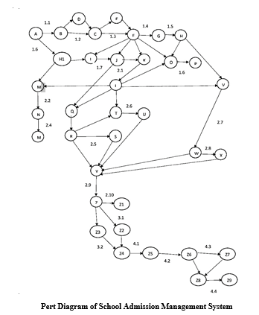
System Planning & Project Scheduling(PERT Diagram)

Slide 15
Risk Management
A risk is a potential problem that might or might not happen. It is necessary to analyze the potential risks in a project. The following categories of risks have been considered in this software project:
Project Risks: Changes the requirements.
Technical Risks: Lack of Experience, Hard Disk Crash.
Business Risks: Insufficient Budget, End Users Accept System.

Slide 16
Quality Assurance & Testing
Quality Assurance makes sure the project will be completed based on the previously agreed specifications, standards and functionality required without defects and possible problems.
System Testing Methods:
Black Box Testing: Black-box testing which is also known as behavioral testing focuses on the functional requirements of the software.
White Box Testing: White-box testing, which also known as glass-box testing, is a test case design method that uses the control structure of the procedural design to derived test cases.

Slide 17
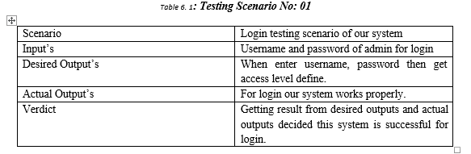
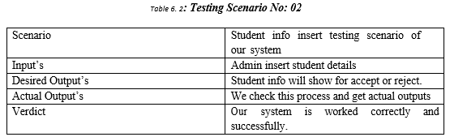
Testing:

Slide 18
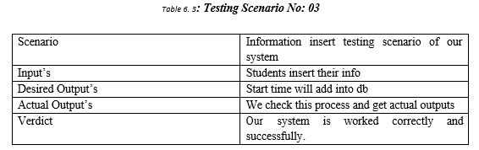
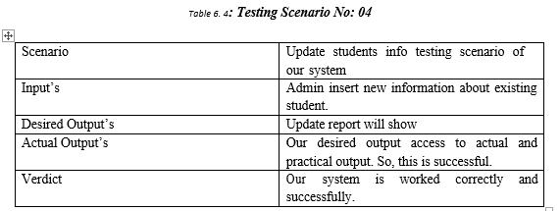
Testing: (Continued)

Slide 19
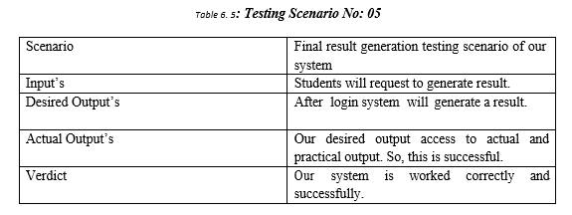
Testing: (Continued)

Slide 20
Limitations
This project has some limitations those we have planned to develop in futures. The limitations are-
Applicants cannot pay admission fee via online payment
Interfaces are little bit complex to understand at first glance.
Embedded account management and some other module is needed to be implemented.
Students will not get any mobile SMS notification for confirmation or rejection.

Slide 21
Future Plan
In future it can be possible to add more features e.g.
Online payment gateway
More backend and database security
More user friendly interface
More module will be included.
Mobile SMS notification (for student)
Change password module for admin
Make a report for the student admission

Slide 22
Conclusion
Our project is only a humble venture to satisfy the needs in Development of School Admission Management System. Several user friendly coding have also adopted. This package shall prove to be a powerful package in satisfying all the requirements of the organizer.

